Slide 1
Using NLP to Predict the Likelihood of Certain Types of Negative Events Occurring with Medical Devices
Melinda Liu

Slide 2
Problem
International Consortium of Investigative Journalists (ICIJ) suspects more than 1.7 million injuries and nearly 83,000 deaths are being linked to medical devices.
ICIJ reports that the U.S. had more than 26,700 device recalls while India — with more than a billion people — had just 14 from 2013 to 2017.
Patients often are the last to be informed about malfunctioning devices.

Slide 3
Benefits of Project
Help medical practitioners make better decisions on which medical devices to use with the most minimal of risks.
Allows patients to be better informed on which medical devices they want to receive.
Give indications to manufacturers on how to better design medical devices with reduction to injury and mortality.

Slide 4
Aim of Project
Identify and study factors via unsupervised learning that influence certain types of negative events that occur with medical devices.
Plan: An unsupervised prediction model using NLP would be created to predict whether a medical device will issue a recall, a safety alert, a field safety notice, or a combination of two or more of them.

Slide 5
Data
International Medical Devices Database
Open Database License
Contents under Creative Commons Attribution-ShareAlike license
Download Link: https://medicaldevices.icij.org/p/download

Slide 6
Data Merging and Cleaning
Merged in outer join fashion the datasets from devices-1562662526.csv, events-1562662544.csv, and manufacturers-1562662522.csv
Text from reason column were lowercased and stemmed with the non-alphabetical text, whitespaces, and stop words removed and denoted to new column called clean_reason
df_final dataset: device_id (ID of the device), device_name (name of device), device_country (country where device was created), event_id (ID of event), action_classification (event risk class), event_country (country where the event took place), reason (textual reasons device is under investigation or reported), type (event type), and clean_reason (cleaned text under reason column)

Slide 7
Initial Findings

Slide 8
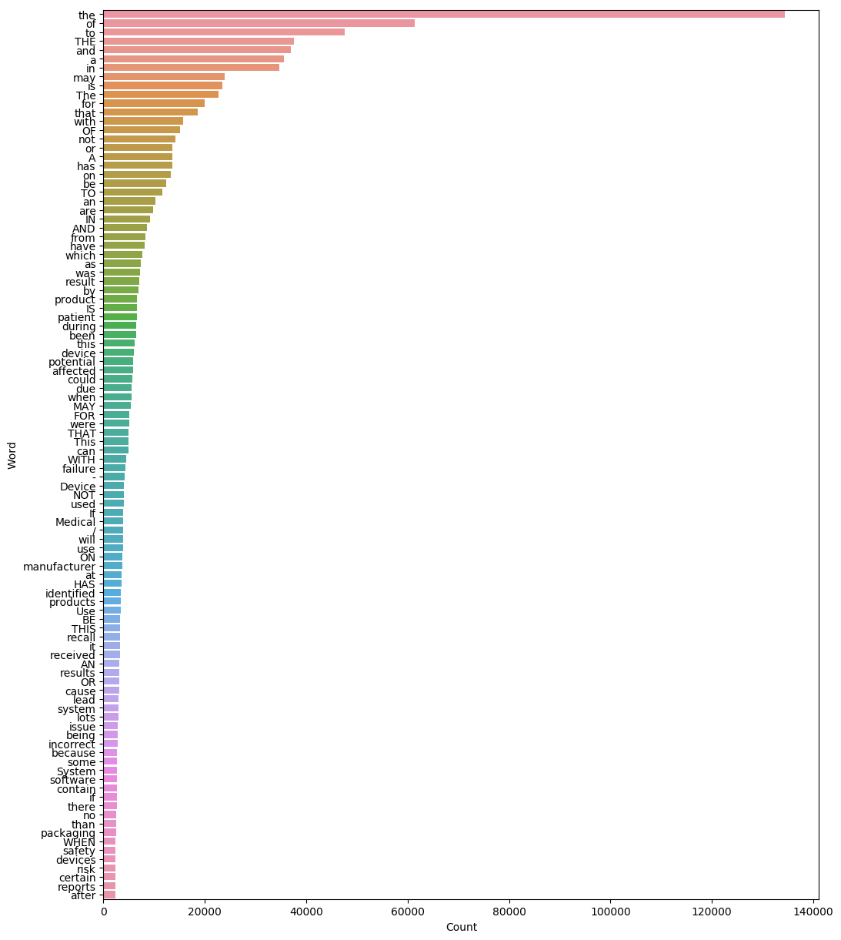
Figure 1: 100 Most Frequent Words of "reason" in df_final

Slide 9
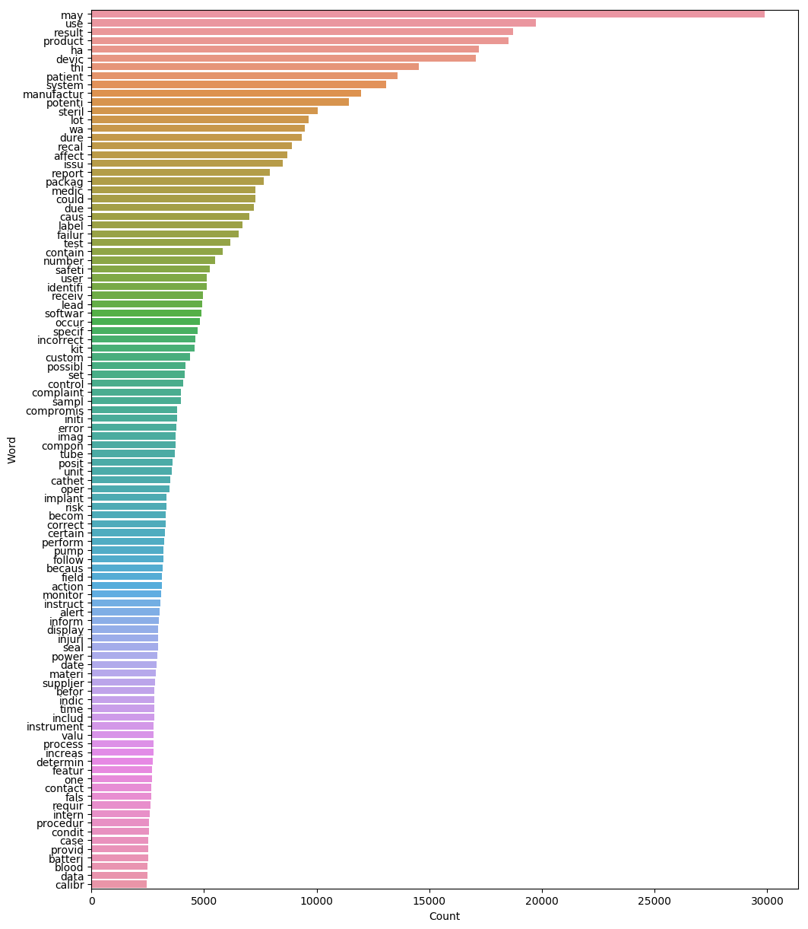
Figure 1: 100 Most Frequent Words of "reason" in df_final
Figure 2: 100 Most Frequent Words of "clean_reason" in df_final

Slide 10
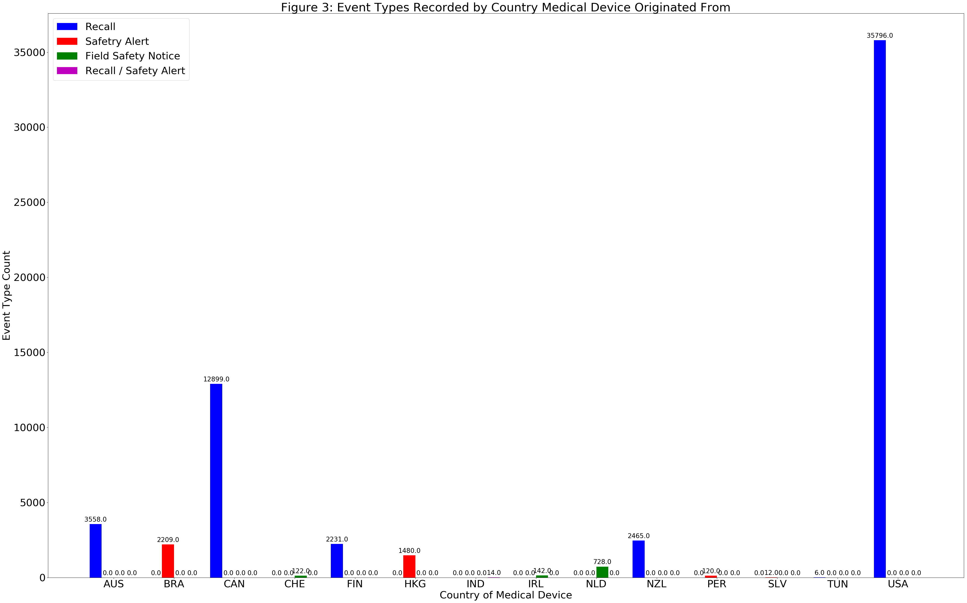
Initial Findings

Slide 11
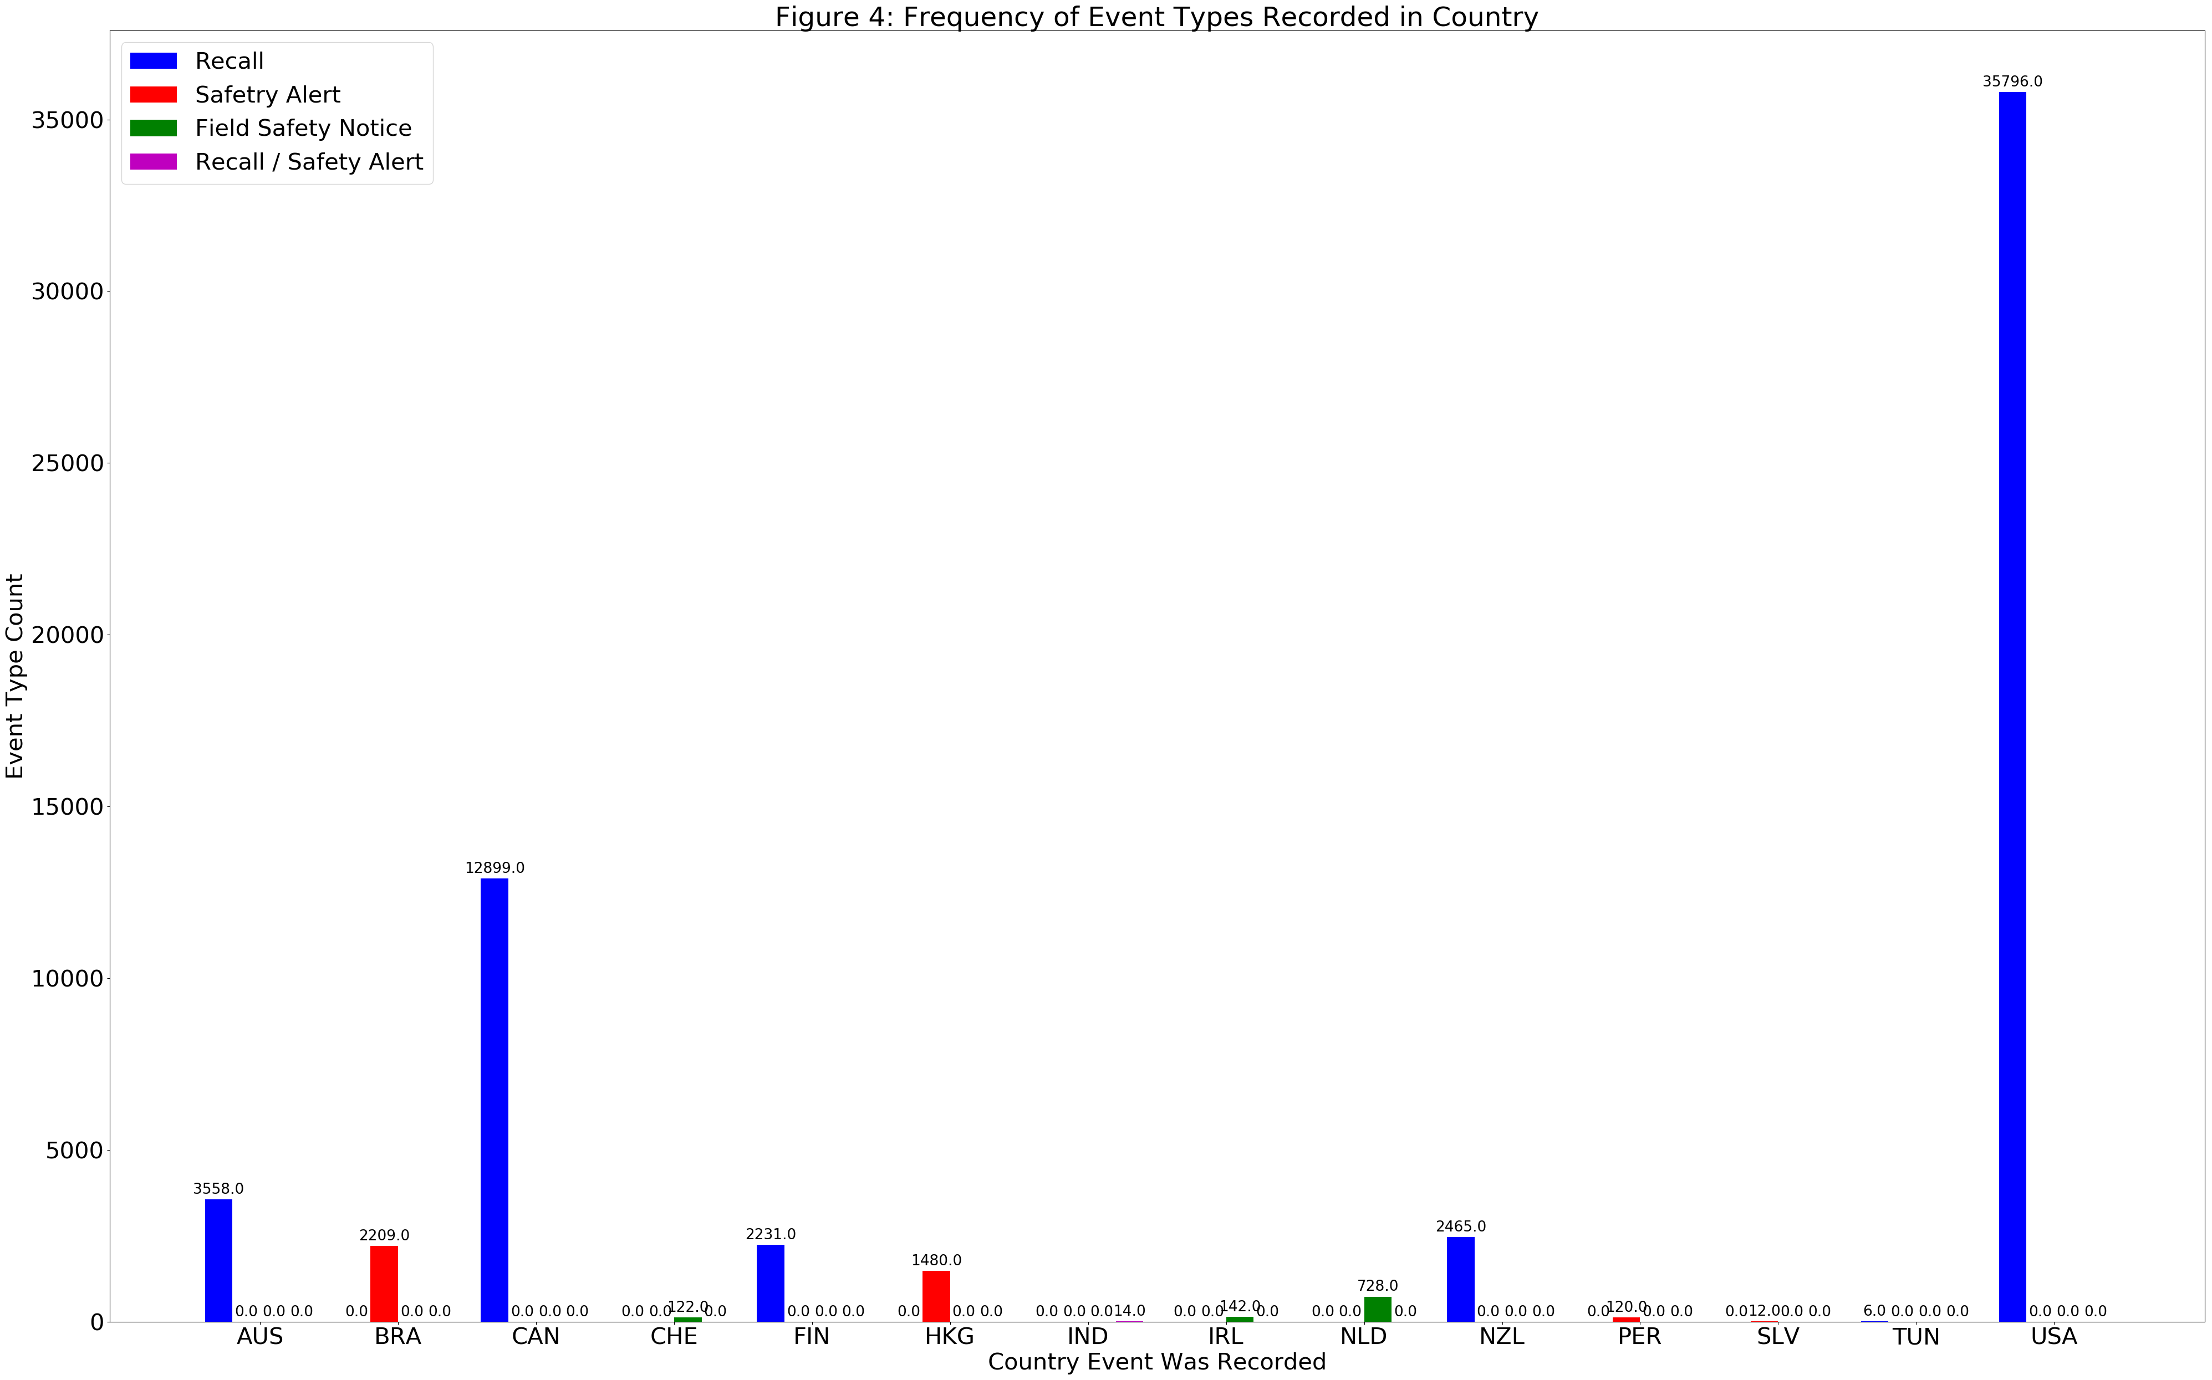
Initial Findings

Slide 12
Statistical Data Analysis
K-Means clustering and Singular Value Decomposition (SVD)
K-Means clustering handles big data well due to its linear time complexity.
SVD is popular in the field of natural language processing (NLP) to create a representation of the large yet sparse word frequency matrices.

Slide 13
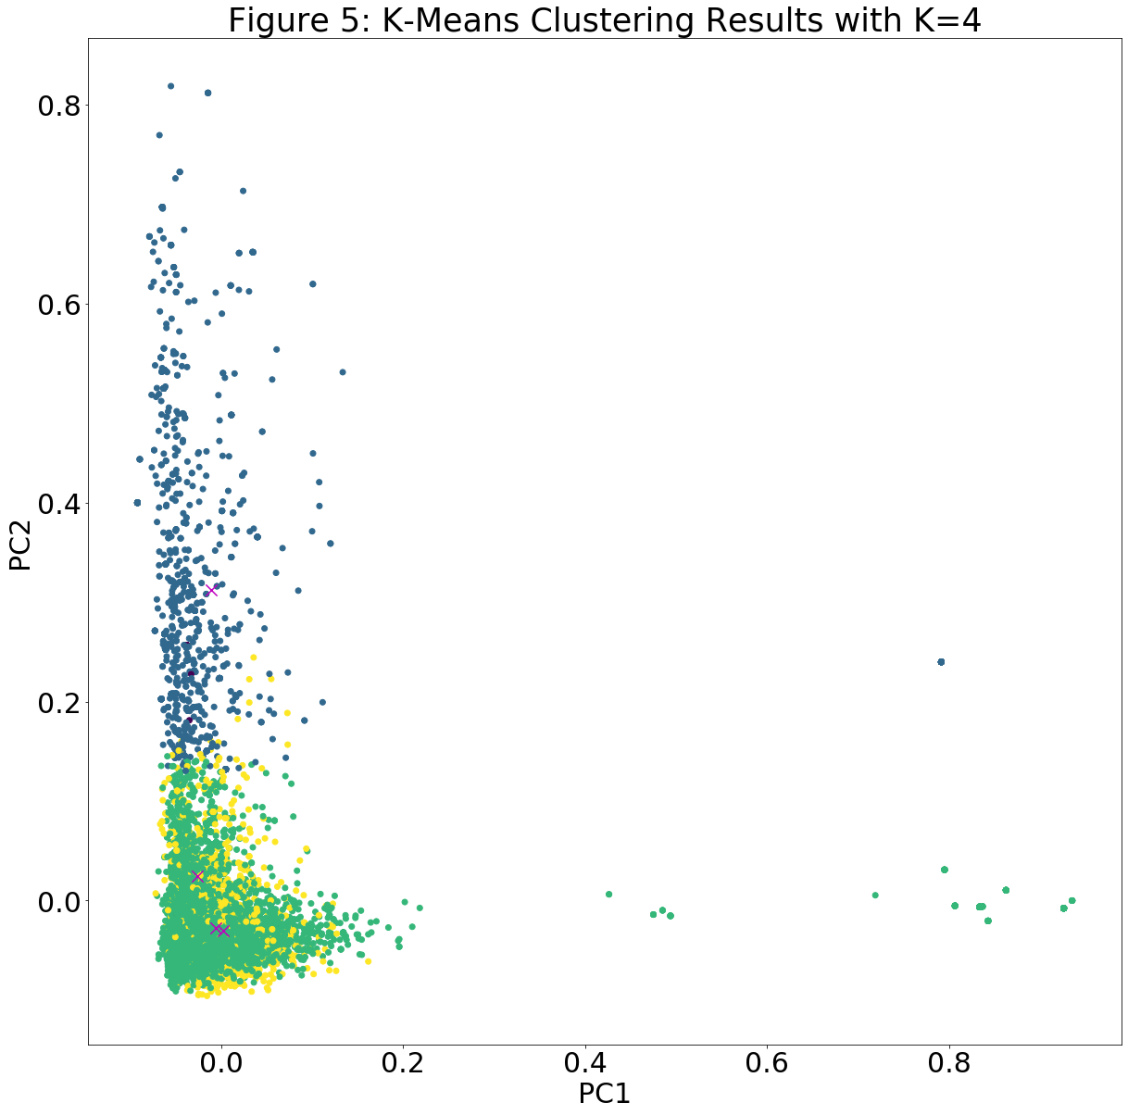

Slide 14
K-Means inference
Homogeneity Score
Ranges between 0 and 1 where 1 stands for perfectly homogeneous labeling
Calculated Score: 0.129
Indicates that labeling of the text data under the clean_reason column based on the discrete values of the type column is not very homogenous.
Silhouette Coefficient
Best value is 1 while worst value is -1
Values near 0 indicate overlapping clusters
Calculated Value: 0.006
Indicates the clusters very much overlap rather than being distinct from each other.

Slide 15
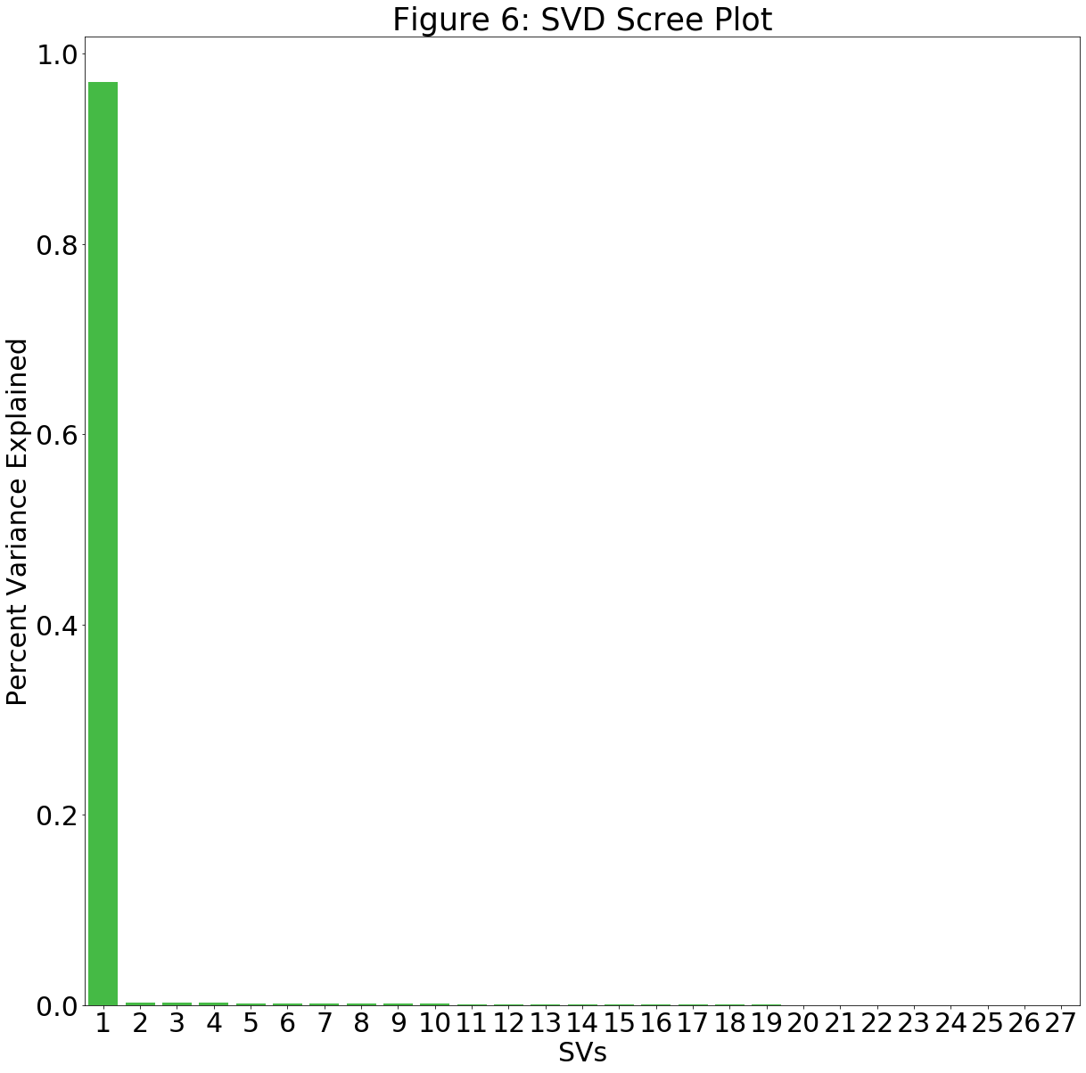

Slide 16
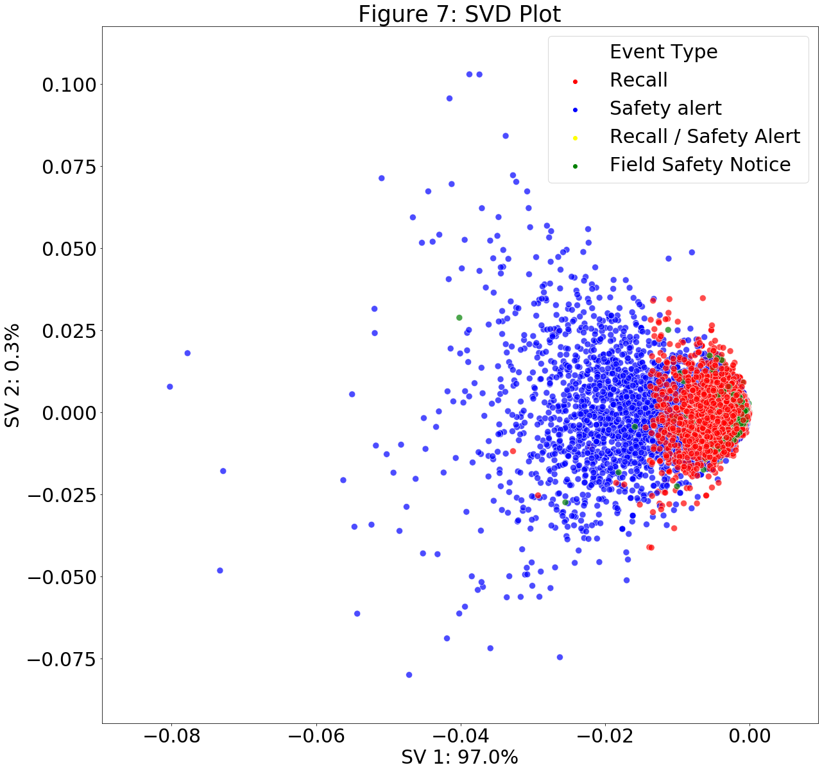

Slide 17
Statistical Inferences
K-Means clustering and SVD indicate the text under the clean_reason column lack any distinct classifications.
K-fold cross validation and a multi-label classification method might improve the classification of the text data in the clean_reason column in the df_final dataset

